Slide 1
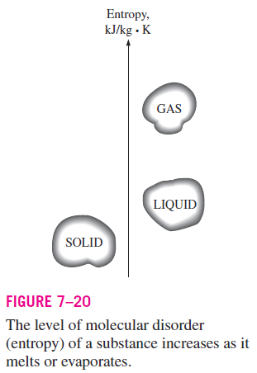
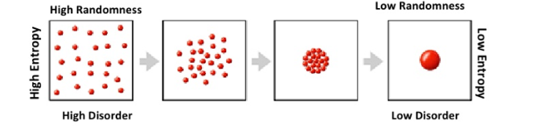
What is Entropy?
Entropy can be defined as a “measure of molecular disorder, or molecular randomness”
For example, entropy of a substance is lowest in the solid phase and highest in the gas phase (Fig. 7–20).

Slide 2
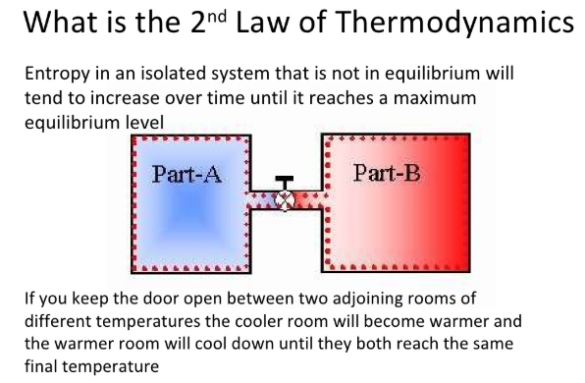
Second law of thermodynamics and Entropy
The second law of thermodynamics can be stated in terms of entropy.
The second law of thermodynamics states that in a reversible process, the entropy of the universe is constant, whereas in an irreversible process, such as the transfer of heat from a hot object to a cold object, the entropy of the universe increases.

Slide 3
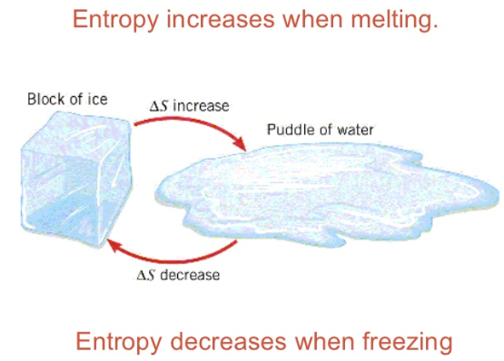

Slide 4
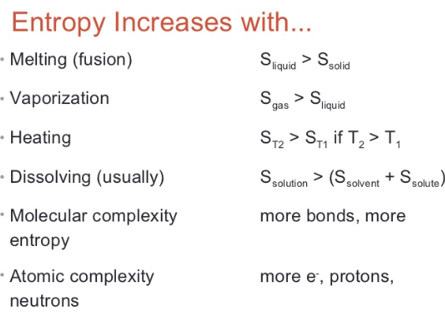
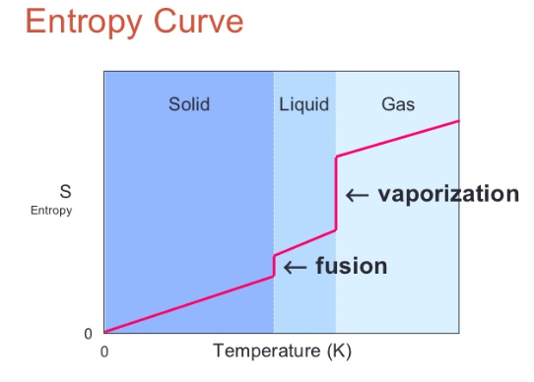

Slide 5
The concept of entropy originated around the mid 19th century, from the study of heat, temperature, work and energy.
The study of how heat could be most efficiently converted to mechanical work was of prime interest.
It was understood that there was a relationship between heat and temperature.
Generally speaking, the more heat you applied to an object, the hotter it got.
It was also understood that heat and work represented different forms of energy and that under the right circumstances, you could convert one into the other.

Slide 6
One of the difficulties was knowing how much heat energy was stored in the hot reservoir.
One couldn't measure the heat content directly. What could be measured was the reservoir's temperature.
If we know the relationship between the temperature and the heat content for that reservoir, we can use the temperature to calculate the heat content.
This became the operational definition of a newly conceived property of systems, a property which came to be known as entropy. (The term was coined in 1865 by Rudolf Clausius)
Simply stated, entropy is the relationship between the temperature of a body and its heat content. Entropy, S, is the heat content, Q, divided by the body's temperature.

Slide 7
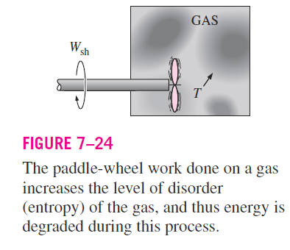
Another definition of entropy according to Hougan and Watson (1959) is related to degradation of energy
“Entropy is an intrinsic property of matter so defined that an increase in the degradation of total energy of the system will lead to increase in entropy.”

Slide 8
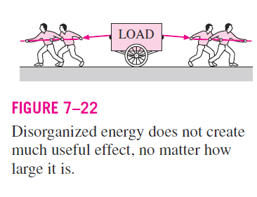
Examples of entropy
Molecules in the gas phase possess a considerable amount of kinetic energy.
However, we know that no matter how large their kinetic energies are, the gas molecules do not rotate a paddle wheel inserted into the container and produce work.
This is because the gas molecules, and the energy they possess, are disorganized.
Probably the number of molecules trying to rotate the wheel in one direction at any instant is equal to the number of molecules that are trying to rotate it in the opposite direction, causing the wheel to remain motionless.
Therefore, we cannot extract any useful work directly from disorganized energy (Fig. 7–22).

Slide 9
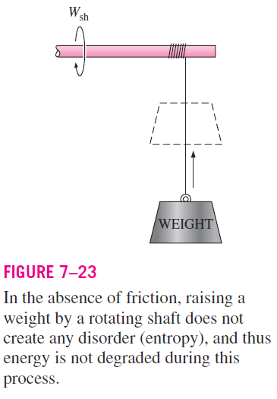
Now consider a rotating shaft shown in Fig. 7–23.
This time the energy of the molecules is completely organized since the molecules of the shaft are rotating in the same direction together.
This organized energy can readily be used to perform useful tasks such as raising a weight or generating electricity.
Being an organized form of energy, work is free of disorder or randomness and thus free of entropy.
There is no entropy transfer associated wit energy transfer as work.
Therefore, in the absence of any friction, the process of raising a weight by a rotating shaft (or a flywheel) does not produce any entropy.
Any process that does not produce a net entropy is reversible, and thus the process just described can be reversed by lowering the weight.
Therefore, energy is not degraded during this process, and no potential to do work is lost.

Slide 10
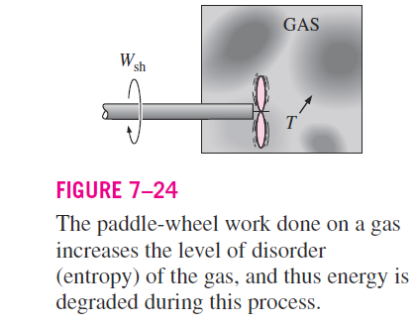
Instead of raising a weight, let us operate the paddle wheel in a container filled with a gas, as shown in Fig. 7–24.
The paddle-wheel work in this case is converted to the internal energy of the gas, as evidenced by a rise in gas temperature, creating a higher level of molecular disorder in the container.
This process is quite different from raising a weight since the organized paddle-wheel energy is now converted to a highly disorganized form of energy, which cannot be converted back to the paddle wheel as the rotational kinetic energy.
Therefore, energy is degraded during this process, the ability to do work is reduced, molecular disorder is produced, and associated with all this is an increase in entropy.

Slide 11
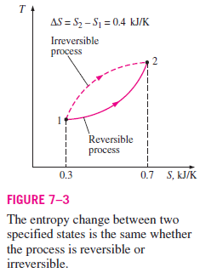
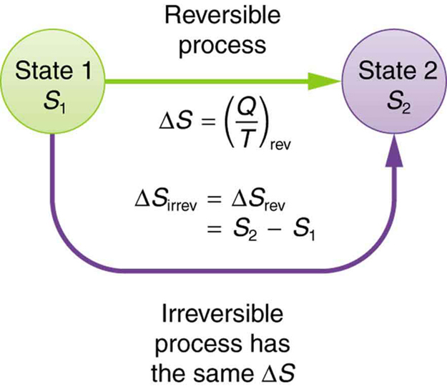
Entropy is an extensive property like volume.
Specific entropy would be entropy per unit mass.
Entropy is a state function like internal energy and enthalpy and depends upon the condition of a system.
Note that entropy is a property, and like all other properties, it has fixed values at fixed states.
Therefore, the entropy change S between two specified states is the same no matter what path, reversible or irreversible, is followed during a process

Slide 12


Clausius realized in 1865 that he had discovered a new thermodynamic property, and he chose to name this property entropy.
It is designated S and is defined as
Entropy is an extensive property of a system and sometimes is referred to as total entropy.
Entropy per unit mass, designated s, is an intensive property and has the unit kJ/kg · K.
The entropy change of a system during a process can be determined by integrating Eq. 7–4 between the initial and the final states:

Slide 13
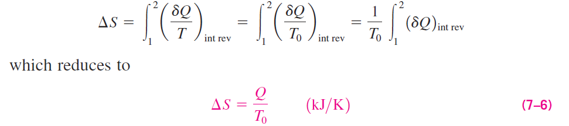
Reversible Isothermal Heat Transfer Processes
The entropy change of a system during reversible isothermal heat transfer process can be determined by performing the integration in Eq. 7–5:
where T₀ is the constant temperature of the system and Q is the heat transfer for the reversible process.

Slide 14
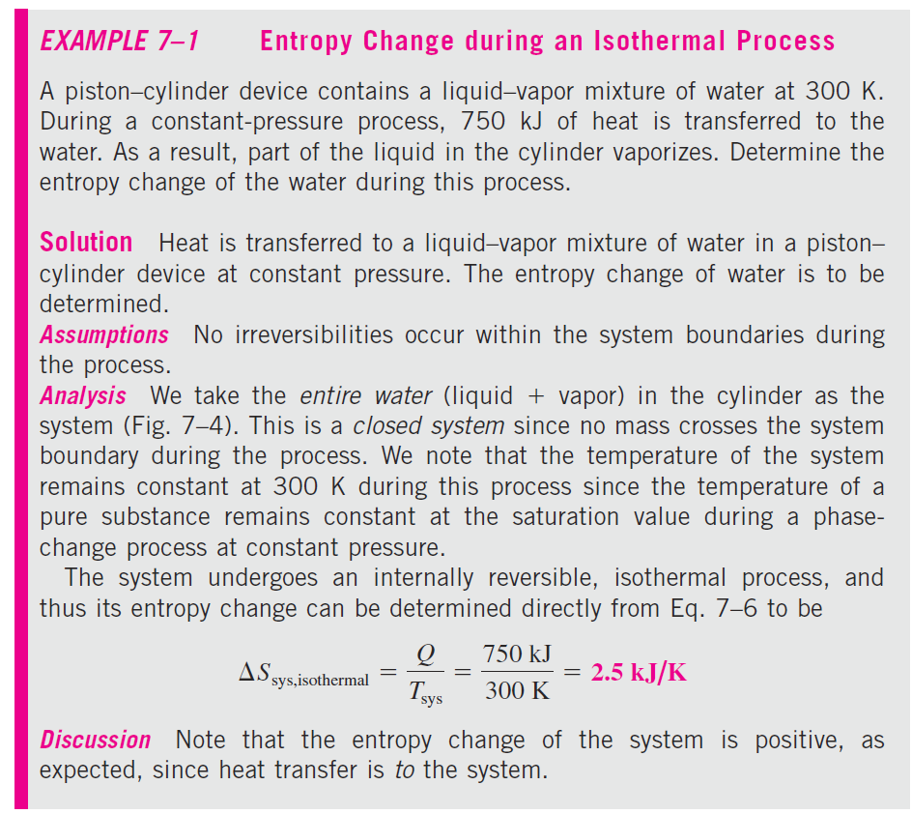
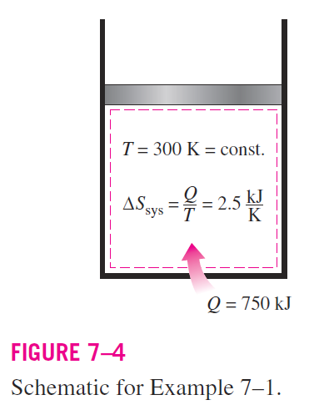

Slide 15
ISENTROPIC PROCESSES
The entropy of a fixed mass does not change during a process that is reversible and adiabatic.
A process during which the entropy remains constant is called an isentropic process.
It is characterized by:

Slide 16
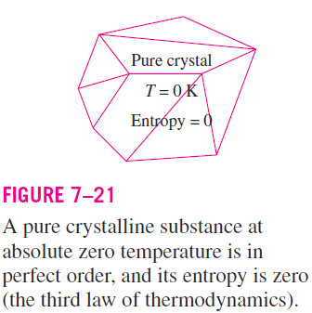
Third law of thermodynamics
The molecules of a substance in solid phase continually oscillate, creating an uncertainty about their position.
These oscillations, however, fade as the temperature is decreased, and the molecules supposedly become motionless at absolute zero.
This represents a state of ultimate molecular order (and minimum energy)
Therefore, the entropy of a pure crystalline substance at absolute zero temperature is zero since there is no uncertainty about the state of the molecules at that instant (Fig. 7–21). This statement is known as the third law of thermodynamics.

Slide 17

Clausius inequality
The second law of thermodynamics often leads to expressions that involve inequalities.
An irreversible (i.e., actual) heat engine, for example, is less efficient than a reversible one operating between the same two thermal energy reservoirs.
Likewise, an irreversible refrigerator or a heat pump has a lower coefficient of performance (COP) than a reversible one operating between the same temperature limits.
Another important inequality that has major consequences in thermodynamics is the Clausius inequality.
It was first stated by the German physicist R. J. E. Clausius (1822–1888), one of the founders of thermodynamics, and is expressed as:
This inequality is valid for all cycles, reversible or irreversible.

Slide 18
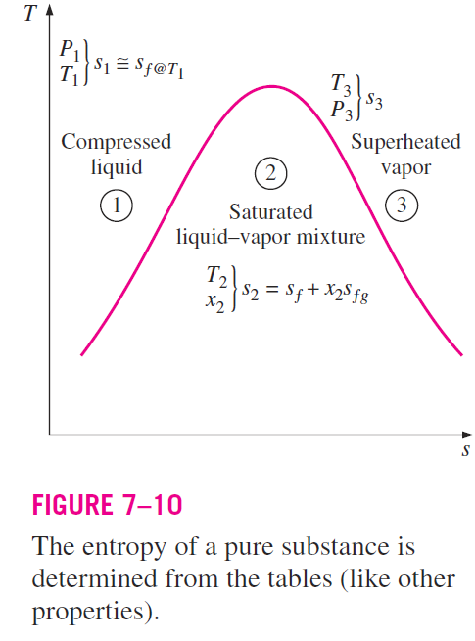

ENTROPY CHANGE OF PURE SUBSTANCES
The value of entropy at a specified state is determined just like any other property.
In the compressed liquid and superheated vapor regions, it can be obtained directly from the tables at the specified state.
In the saturated mixture region, it is determined from
where x is the quality and s_{f} and s_{fg} values are listed in the saturation tables.

Slide 19
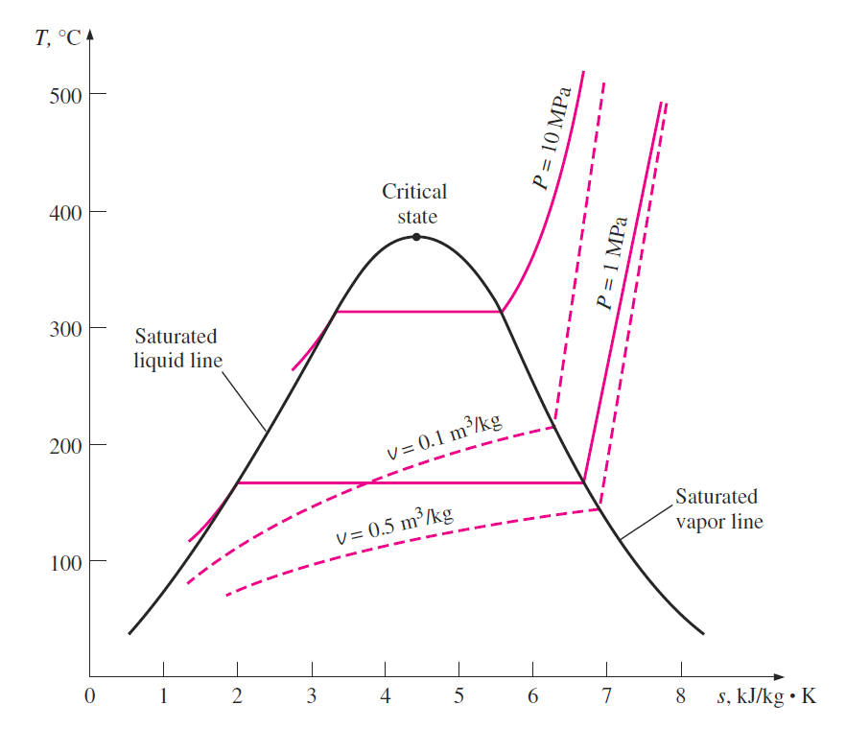
Entropy is commonly used as a coordinate on T-s diagram
The general characteristics of the T-s diagram of pure substances are shown in Fig. 7–11 using data for water.
Notice from this diagram that the constant volume lines are steeper than the constant-pressure lines and the constant pressure lines are parallel to the constant-temperature lines in the saturated liquid–vapor mixture region.
Also, the constant-pressure lines almost coincide with the saturated liquid line in the compressed liquid region.

Slide 20
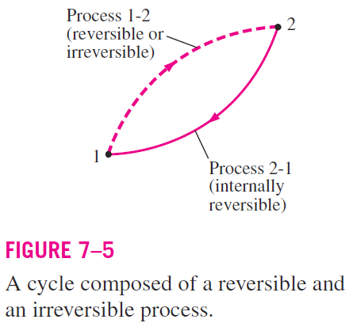
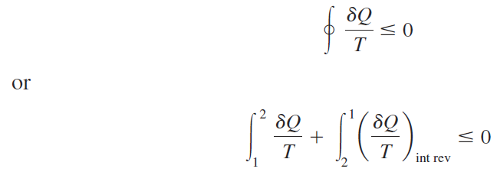
THE INCREASE OF ENTROPY PRINCIPLE
Consider a cycle that is made up of two processes: process 1-2, which is arbitrary (reversible or irreversible), and process 2-1, which is reversible, as shown in Figure 7–5.
From the Clausius inequality,
The second integral in the previous relation is recognized as the entropy change S₁ - S₂.

Slide 21
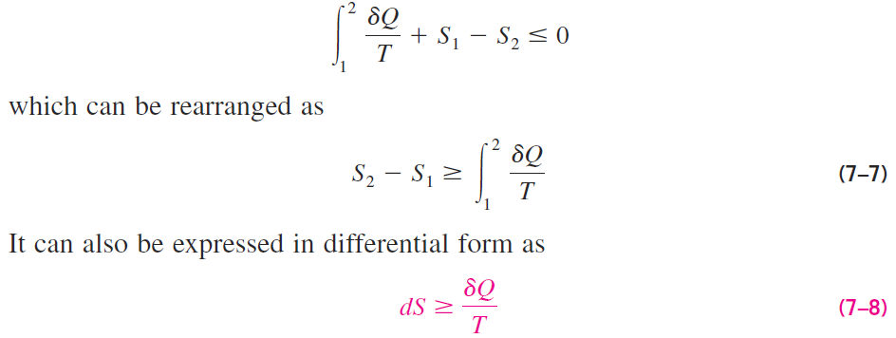

Therefore,
where the equality holds for an internally reversible process and the
inequality for an irreversible process.
T = Thermodynamic temperature
ΔS = S₂ – S₁ = entropy change of the system
= entropy transfer with heat

Slide 22

The inequality sign in the previous equation (7-8) shows that the entropy change of a closed system during an irreversible process is always greater than the entropy transfer.
That is, some entropy is generate or created during an irreversible process, and this generation is due entirely to the presence of irreversibilities.
The entropy generated during a process is called entropy generation and is denoted by S_{gen}
Noting that the difference between the entropy change of a closed system and the entropy transfer is equal to entropy generation
Eq. 7–7 can be rewritten as an equality as:

Slide 23
For an isolated system (or simply an adiabatic closed system), the heat transfer is zero, and Eq. 7–7 reduces to
This equation can be expressed as the entropy of an isolated system during a process always increases or, in the limiting case of a reversible process, remains constant.
In other words, it never decreases. This is known as the increase of entropy principle.

Slide 24
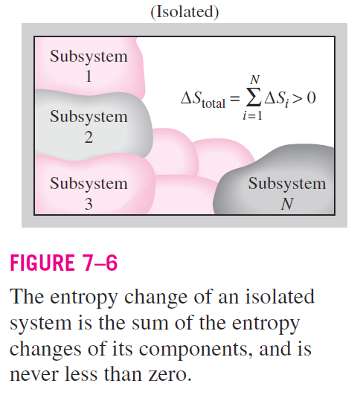
Entropy is an extensive property, and thus the total entropy of a system is equal to the sum of the entropies of the parts of the system.
An isolated system may consist of any number of subsystems (Fig. 7–6).

Slide 25
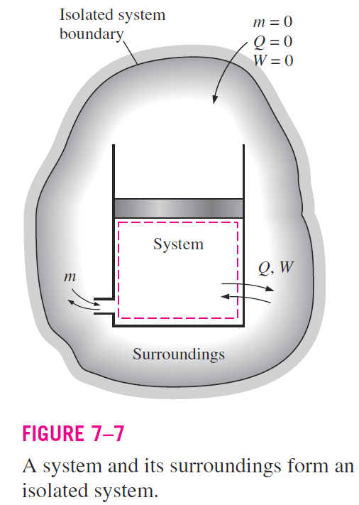
A system and its surroundings, for example, constitute an isolated system since both can be enclosed by a sufficiently large arbitrary boundary across which there is no heat, work, or mass transfer (Fig. 7–7).
Therefore, a system and its surroundings can be viewed as the two subsystems of an isolated system,
The entropy change of this isolated system during a process is the sum of the entropy changes of the system and its surroundings, which is equal to the entropy generation since an isolated system involves no entropy transfer.
That is,

Slide 26
Since no actual process is truly reversible, we can conclude that some entropy is generated during a process, and therefore the entropy of the universe, which can be considered to be an isolated system, is continuously increasing.
The more irreversible a process, the larger the entropy generated during that process.
No entropy is generated during reversible processes (S_{gen} = 0).
Entropy increase of the universe is a major concern not only to engineers but also to economists and environmentalists since entropy is viewed as a measure of the disorder (or “mixed-up-ness” in the universe.

Slide 27
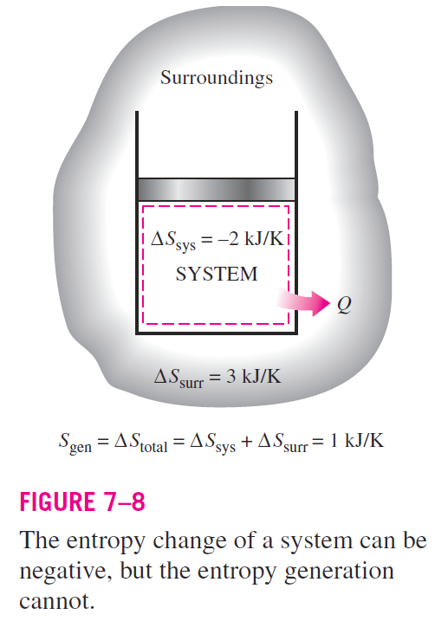
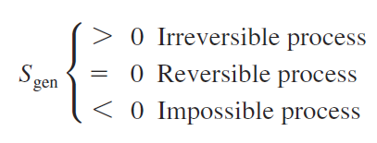
The increase of entropy principle does not imply that the entropy of a system cannot decrease.
The entropy change of a system can be negative during a process (Fig. 7–8), but entropy generation cannot.
The increase of entropy principle can be summarized as follows:

Slide 28
PROPERTY DIAGRAMS INVOLVING ENTROPY
Property diagrams serve as great visual aids in the thermodynamic analysis of processes.
We have used P-v and T-v diagrams extensively in previous chapters in conjunction with the first law of thermodynamics.
In the second law analysis, it is very helpful to plot the processes on diagrams for which one of the coordinates is entropy.
The two diagrams commonly used in the second-law analysis are the temperature-entropy and the enthalpy-entropy diagrams.

Slide 29
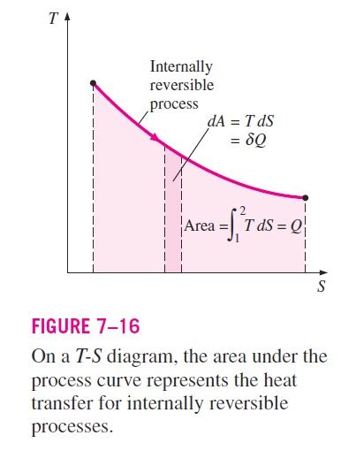



Temperature-entropy diagram
Consider the defining equation of entropy (Eq. 7–4). It can be rearranged as
As shown in Fig. 7–16, corresponds to a differential area on a T-S diagram.
The total heat transfer during an internally reversible process is determined by integration to be
which corresponds to the area under the process curve on a T-S diagram.

Slide 30
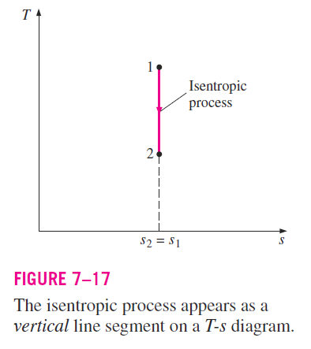
An isentropic process on a T-s diagram is easily recognized as a vertical line segment.
This is expected since an isentropic process involves no heat transfer, and therefore the area under the process path must be zero (Fig. 7–17).

Slide 31
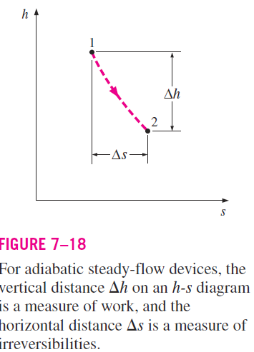
Enthalpy-entropy diagram
Another diagram commonly used in engineering is the enthalpy-entropy diagram, which is quite valuable in the analysis of steady-flow devices such as turbines, compressors, and nozzles.
The coordinates of an h-s diagram represent two properties of major interest: enthalpy, which is a primary property in the first-law analysis of the steady-flow devices,
and entropy, which is the property that accounts for irreversibilities during adiabatic processes.

Slide 32
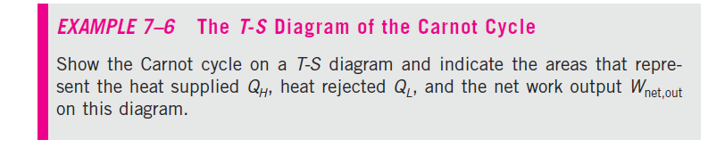
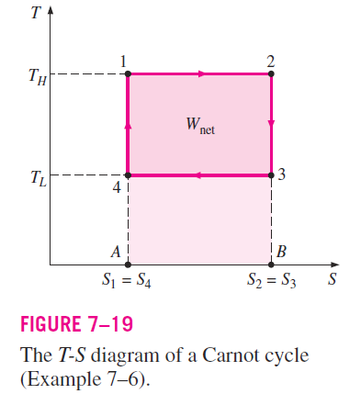

Recall that the Carnot cycle is made up of two reversible isothermal
(T = constant) processes and two isentropic (s = constant) processes.
These four processes form a rectangle on a T-S diagram, as shown in Fig.
7–19.
On a T-S diagram, the area under the process curve represents the heat
transfer for that process. Thus the area A12B represents Q_{H}, the area A43B
represents Q_{L}, and the difference between these two (the area in color) represents the net work since
Therefore, the area enclosed by the path of a cycle (area 1234) on a T-S diagram represents the net work.

